Slide 1



DEPARTMENT OF ELECTRONICS AND COMMUNICATION ENGINEERING
18ECP105L-MINOR PROJECT- III
PROJECT REVIEW
ADVANCED SECURITY SYSTEM UTILIZING ESP32 CAMERA FOR SMART FEATURES
PRESENTED BY:
DEEPAN S (927622BEC028)
GIRIVASAN MV (927622BEC054)
GURU KARTHIKEYAN(927622BEC062)
HARIRAJAN M(927622BEC066)
GUIDED BY
Dr . S.VIMALNATH
ASSOCIATE PROFESSOR

Slide 2
OBJECTIVE
The Advanced Security System Utilizing ESP32 Camera for Smart Features is designed to enhance safety for both homes and bikes by leveraging smart technology and real-time monitoring. For home safety, the system provides 24/7 surveillance with features like motion detection, face recognition, and remote accessibility. Homeowners can monitor live video feeds on their smartphones, receive instant alerts for unauthorized access, and even integrate the system with other smart devices, such as automated door locks or lighting systems, for enhanced security

Slide 3
ABSTRACT
This paper introduces an advanced smart security system designed for bike and home locks, utilizing the ESP32- CAM WiFi Bluetooth Development Board with OV2640 Camera Module. The system combines real-time video monitoring, motion detection, and face recognition to enhance traditional locking mechanisms with smart features. Leveraging the ESP32-CAM’s WiFi and Bluetooth connectivity, the solution enables remote access, real-time alerts, and secure unlocking via authorized facial identification or mobile app controls. The OV2640 camera mod- ule ensures high-quality image capture for reliable recognition, while the system’s compact and energy-efficient design makes it ideal for portable and stationary security applications. This IoT-enabled approach redefines lock systems, offering enhanced security, convenience, and scalability for personal and residential use.

Slide 4
INTRODUCTION
In today’s world, ensuring the safety of homes and personal assets, such as bikes, has become a priority for individuals. With the increasing demand for affordable and efficient security solutions, the Advanced Security System Utilizing ESP32 Camera for Smart Features presents an innovative approach to safeguarding homes and bikes. This system employs the ESP32 camera module, known for its compact design, energy efficiency, and cost-effectiveness, as the core component for real-time video monitoring and smart security functionalities.

Slide 5
LITERATURE SURVEY
Author(s) | Year | Focus Area | Key Findings | Limitations
Rodrigues et al. | 2020 | ESP32 Camera in Security Systems | Demonstrated ESP32's versatility in applications like face detection and IoT-based monitoring. | Limited processing power and storage capacity require optimization for advanced use cases.
Singh et al. | 2022 | Integration of Smart Features | Highlighted the benefits of automation and real-time alerts in reducing response times. | Systems require high technical expertise for implementation and maintenance.

Slide 6
EXISTING METHOD
Conventional CCTV cameras provide video monitoring but require on-site supervision and lack smart features like motion detection or real-time notifications. Mechanical locks, while effective in restricting access, are vulnerable to tampering and cannot be monitored or controlled remotely. Similarly, standalone alarm systems trigger alerts upon unauthorized access but typically operate locally without providing visual confirmation or remote updates. These systems often function independently, lacking integration between video surveillance, access control, and automated threat responses. As a result, traditional methods are limited in efficiency, adaptability, and the ability to handle dynamic security challenges, making them less suitable for modern safety requirements.

Slide 7
PROPOSED METHOD
The proposed method for the Advanced Security System Utilizing ESP32-CAM involves integrating smart IoT components with physical access control mechanisms to provide efficient and reliable safety solutions for homes and bikes. The system begins with the configuration of the ESP32-CAM, which connects to a WiFi network for remote monitoring and control. The OV2640 camera captures real-time video, allowing live surveillance and motion detection. Upon detecting motion or suspicious activity, the system triggers automated actions such as sending notifications, locking doors using the 12V electronic door lock via the 5V single-channel relay module, and activating alarms if connected. The relay module enables safe and efficient control of high-power components like the solenoid lock while maintaining electrical isolation. Users can remotely unlock doors or monitor the video feed through a mobile application or web browser.

Slide 8
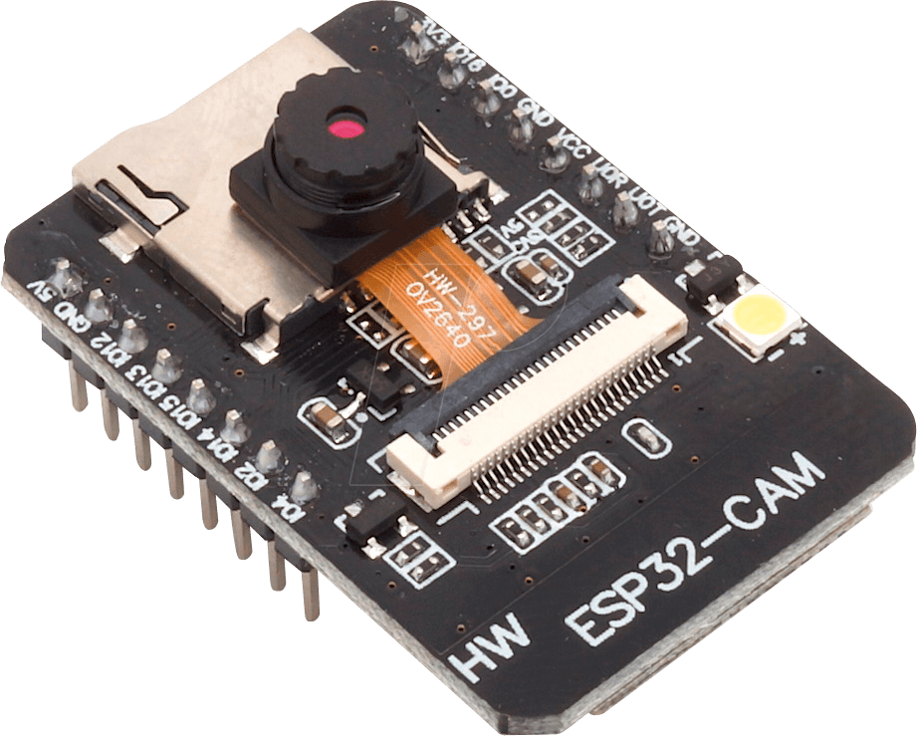
COMPONENTS
ESP32 CAM
FT232RL USB to TTL 3.3V 5V Serial Adapter Module for Arduino
12V Electronic Door Lock assembly Solenoid low power consumption
5V Single Channel RELAY Module

Slide 9
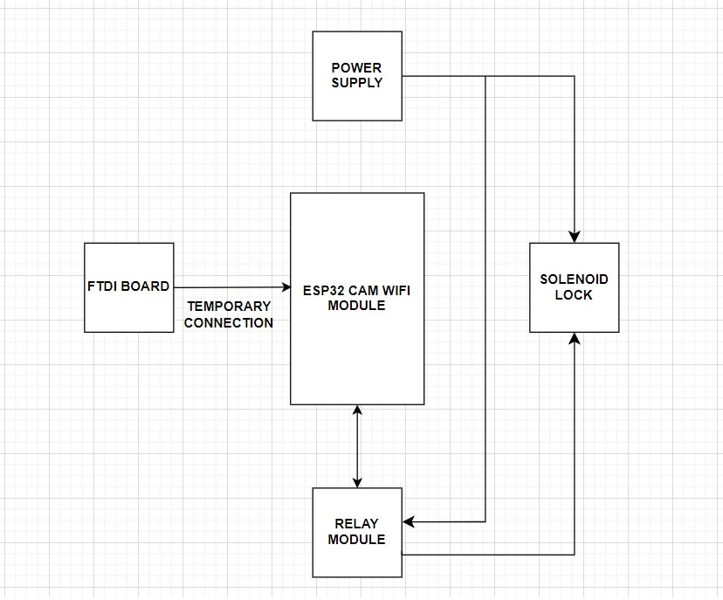
BLOCK DIAGRAM

Slide 10
CONCLUSION
In conclusion, the Advanced Security System Using ESP32-CAM and Relay Module is a smart and affordable solution for enhancing home and bike safety. It provides real-time video monitoring, motion detection, and automated access control. With features like remote control and alerts via WiFi, the system ensures convenience and security. This project overcomes the limitations of traditional methods, offering an efficient and reliable way to protect your home and belongings.

Slide 11
ADVANTAGES
Energy Efficient
Real-Time Monitoring
Smart Features
Scalability
Enhanced Security
Remote Accessibility
Customizable
Easy Installation
Integration with Smart Devices
Data Privacy and Security
Bike Safety

Slide 12
APPLICATIONS
Home Security
Bike Safety
Commercial Property Protection
Smart Home Integration
Public Safety

Slide 13
REFERENCES
1.Kumar, S., & Patel, R. (2019). IoT-Based Home Security Systems: A Comprehensive Survey. International Journal of Computer Applications, 178(29), 1-8.
2.Zhou, X., & Wang, H. (2020). Applications of ESP32 in IoT-Based Smart Security Systems. International Journal of Embedded Systems, 7(2), 110-115.
3.Nayak, S., & Rao, V. (2021). Low-Cost Smart Surveillance System Using ESP32-CAM and Motion Detection. Journal of Embedded Systems and Applications, 6(4), 80-85.

Slide 14
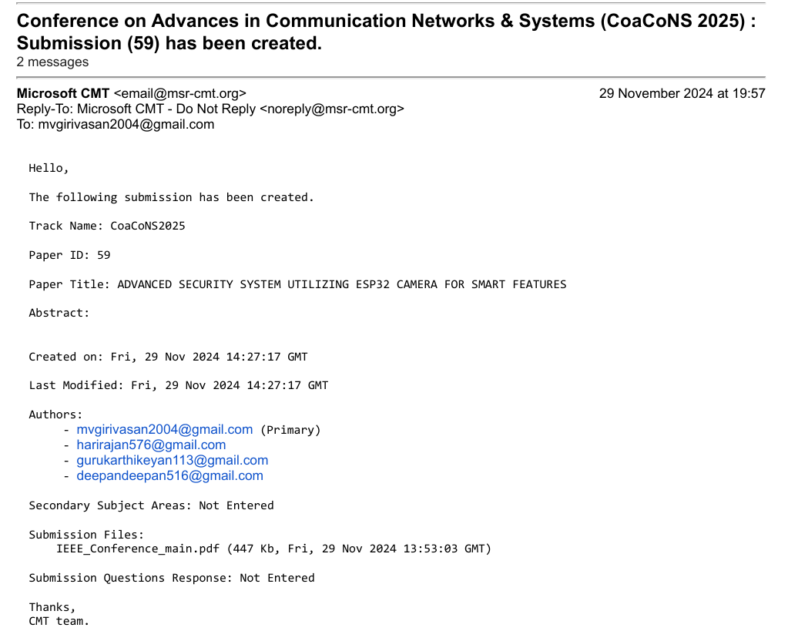
PROJECT OUTCOME

Slide 15


